Slide 1
Group 6
RESEARCH PROJECT PRESENTATION
Scalable GraphRAG: Hybrid Retrieval with Apache Spark
Integrating Knowledge Graph Topology with LLM Generation for Multi-Hop Question Answering
Project Team: Group 6
Course: MSBD 5003
April 2026
GRAPHRAG

Slide 2
Agenda
TABLE OF CONTENTS
01
Background & Motivation
From Vector RAG to GraphRAG
02
Data Processing & Knowledge Graph Construction
Wikipedia + DBpedia to Unified Knowledge Graph
03
Graph Analytics
PageRank, Louvain & Scalability Validation
04
RAG System — Hybrid Retrieval
Graph-Guided Evidence Retrieval
05
Evaluation Framework
HotpotQA Benchmark & Ablation Study
2

Slide 3
01
Background & Motivation
CHAPTER ONE
Why we need GraphRAG + Spark for large-scale multi-hop reasoning
3

Slide 4
Experiment Background
01 Background & Motivation
Retrieval-Augmented Generation (RAG): retrieve relevant information from an external knowledge base, then feed it as context to the LLM
1
The Rise of LLMs and RAG
Retrieval-augmented generation (RAG) enables large language models (LLMs) to accurately answer questions based on private or previously unseen document collections by retrieving relevant information from external knowledge sources.
2
Frontier Theoretical Exploration (GraphRAG)
Recent research proposes using LLMs to build an entity knowledge graph and pre-generate community summaries. Compared to a conventional RAG baseline, this graph-based architecture leads to substantial improvements in both the comprehensiveness and diversity of generated answers for global questions.
4

Slide 5
Limitations of Traditional RAG
01 Background & Motivation
Difficulty in Answering Global and Holistic Questions
Search results are limited by the context window
Lack of comprehensiveness and diversity
Traditional RAG is better suited for answering localized questions, but performs poorly on questions that require an understanding of the entire corpus. For example, a question like “What is the main theme of this dataset?” is essentially a corpus-wide query-focused summarization task, rather than a simple retrieval task.
Standard RAG retrieves a small subset of records from a large external corpus that are semantically similar to the query and fit within the LLM’s context window, and then generates a response based on those records. The system may fail to capture important information scattered across multiple documents, and this limited scope of retrieval can compromise the quality of the response.
GraphRAG significantly outperforms traditional vector RAG in terms of answer comprehensiveness and diversity. Compared to vector RAG, GraphRAG performs better than traditional RAG across a variety of tasks and is better suited for tasks that focus on the entire corpus..
Core Insight:Traditional RAG excels at retrieving specific facts, but in tasks requiring cross-document, cross-topic, and holistic understanding, it suffers from issues such as insufficient coverage, fragmented information, and incomplete answers.
5

Slide 6
Project Motivation & Goals
01 Background & Motivation
Breaking the Limits of Single-Modal Retrieval
Fusing Structural and Semantic Features
This project aims to overcome the limitations of pure vector retrieval by building a Hybrid Retrieval System that deeply integrates Big Data graph analysis with LLMs.
By implementing a hybrid mechanism of "structured graph retrieval + vector retrieval," the system applies graph algorithms for topological weighting to provide LLMs with a more accurate and logical context augmentation.
Conquering the Scalability Challenge in Massive Graph Construction
End-to-End Validation
Leveraging Apache Spark's massive parallel computing capabilities, the project extracts entities and relationships from unstructured text corpora to resolve the performance bottlenecks in building massive Knowledge Graphs.
With Spark at its core for distributed processing , the ultimate goal is to verify accuracy improvements on multi-hop queries and provide a highly efficient, scalable Big Data + AI solution for knowledge-augmented generation tasks.
7

Slide 7
Core Innovations
01 Background & Motivation
INNOVATION 1
INNOVATION 2
INNOVATION 3
Hybrid Retrieval
Vector semantic search combined with graph structural search via explicit entity relation chains, unifying semantic and topological signals.
PageRank + Louvain
PageRank scores node/edge importance for ranking; Louvain detects semantic communities for retrieval expansion and disambiguation.
Spark at Scale
Distributed parsing, extraction, cleaning, fusion, and export pipeline for Wikipedia-level unstructured + DBpedia structured data integration.
Technical Impact
Scalable KG Construction
153K nodes and 115K edges from 50K Wikipedia articles using Spark
Graph-Guided Retrieval
Graph produces retrieval paths; evidence chunks are primary context
Reproducible Benchmark
HotpotQA-based local evaluation set for controlled ablation study
8

Slide 8
02
Data Processing & Knowledge Graph Construction
CHAPTER TWO
From Wikipedia + DBpedia to a unified, structured knowledge graph
9

Slide 9
Dataset Input
02 Data Processing & Knowledge Graph Construction
Wikipedia Unstructured Corpus
DBpedia Structured Graph Seed
This dataset consists of high-quality structured triples extracted by the DBpedia community from Wikipedia infoboxes. In this project, we directly import this high-confidence, ready-to-use linked data into the system to serve as seed data for initializing the graph. This not only effectively addresses the cold-start problem in graph construction and significantly accelerates the overall construction process, but also lays the foundation for subsequent graph algorithm operations and multi-hop hybrid retrieval.
• Serves as initial graph seed
• Loaded into Spark DataFrame
• Reduces cold-start difficulty
• Structured S-P-O relations
This dataset is derived from a large-scale subset of the English Wikipedia and contains approximately 6.8 million pages of unstructured plain text from article bodies. In our project, it serves as the core knowledge base underpinning the system. We will leverage the distributed parallel processing capabilities of the Spark framework to parse the data, combining custom rules and algorithms to dynamically mine and extract entities as well as hidden complex relationships from this vast corpus of natural language text.
• Multistream format with index
• 50K articles for experiments
• Distributed parsing via Spark mapPartitions
• Rich textual content with hidden relations
+
10

Slide 10
Data Pipeline & Extraction
02 Data Processing & Knowledge Graph Construction
Raw Dump Parsing & Data Ingestion
Distributed Entity & Relation Extraction
Multi-source Heterogeneous Parsing: Utilizes spark-xml to read Wikipedia XML snapshots in parallel, and employs a predicate whitelist to accurately parse DBpedia’s structured TTL files.
Cleaning and Standardization: Remove Wiki markup, templates, and noise; generate globally unique IDs based on article titles and body text using the SHA-256 algorithm.
Unified Storage Engine: Align unstructured long-form text and structured seed data into a unified Spark DataFrame, and consolidate it into an underlying data lake.
Cluster-level operator deployment: Complex regular expression matching and syntactic analysis logic are encapsulated as Spark UDFs to enable distributed text mining on the server.
Dynamic semantic extraction: Overcoming the limitations of plain text, the system dynamically extracts latent semantic triples from 50,000 unstructured long-form documents.
Precise Quality Control: Built-in entity filtering rules (removing malformed words, resolving ambiguous pronouns, and filtering generalized events) ensure high confidence in newly extracted knowledge.
Pipeline Summary
• Distributed Data Ingestion:Leveraged Spark to seamlessly parse and align massive Wikipedia XML dumps and DBpedia TTL seeds into a unified DataFrame.
• Scalable Relation Extraction:Deployed custom Spark UDFs to dynamically mine high-value semantic triples from 50K unstructured articles at scale.
• Automated Quality Control:Applied rigorous text cleaning, deduplication, and entity filtering rules to ensure a high-confidence data foundation for graph construction.
11

Slide 11
Knowledge Graph Construction
02 Data Processing & Knowledge Graph Construction
Entity Canonicalization & Disambiguation
Entity Naming Alignment: Unify entity namespaces through multiple rules.
Heterogeneous Knowledge Base Fusion: Aggregate tuples dynamically extracted from Wikipedia with those from DBpedia.
Type Inference Filtering: Automatically infer physical attributes for entities and accurately filter out low-quality noise nodes.
Graph Topology Generation
Edge-based mapping system: Based on an aggregated triplet network, establish globally independent tables for graph vertices and edges.
Create an entity dictionary: Simultaneously generate a mapping table (Entity Lookup) from original names to standard names to provide dictionary support for subsequent retrieval and alignment.
OUTPUT
Standardizing the generated 100,000-node edge network into Parquet columnar format significantly reduces overhead. Simultaneously generating lightweight JSONL files provides comprehensive support for subsequent tasks.
13

Slide 12
Knowledge Graph Construction Results
02 Data Processing & Knowledge Graph Construction
50K
153,331
114,896
Wikipedia Articles Processed
Entities (Vertices)
Relations (Edges)
Source Analysis
DBpedia Structured (86.2%)
Text Dynamic Extraction (13.8%)
Key Insight:
The hybrid fusion of curated structured seeds and dynamically extracted text triples generated a topological structure. This validated the scalability of our Spark pipeline.
The current extraction rules are too strict, resulting in 86% of relationships relying on external DBpedia seeds, with an average extraction rate of only 0.32 per article and an excessively low semantic network density.
We are optimizing the logic to increase the density of endogenous triples while preserving semantic relationships, thereby supporting GraphRAG’s multi-hop reasoning and deep path discovery.
14

Slide 13
03
Graph Analytics
CHAPTER THREE
PageRank, Louvain Community Detection & Scalability Validation
15

Slide 14
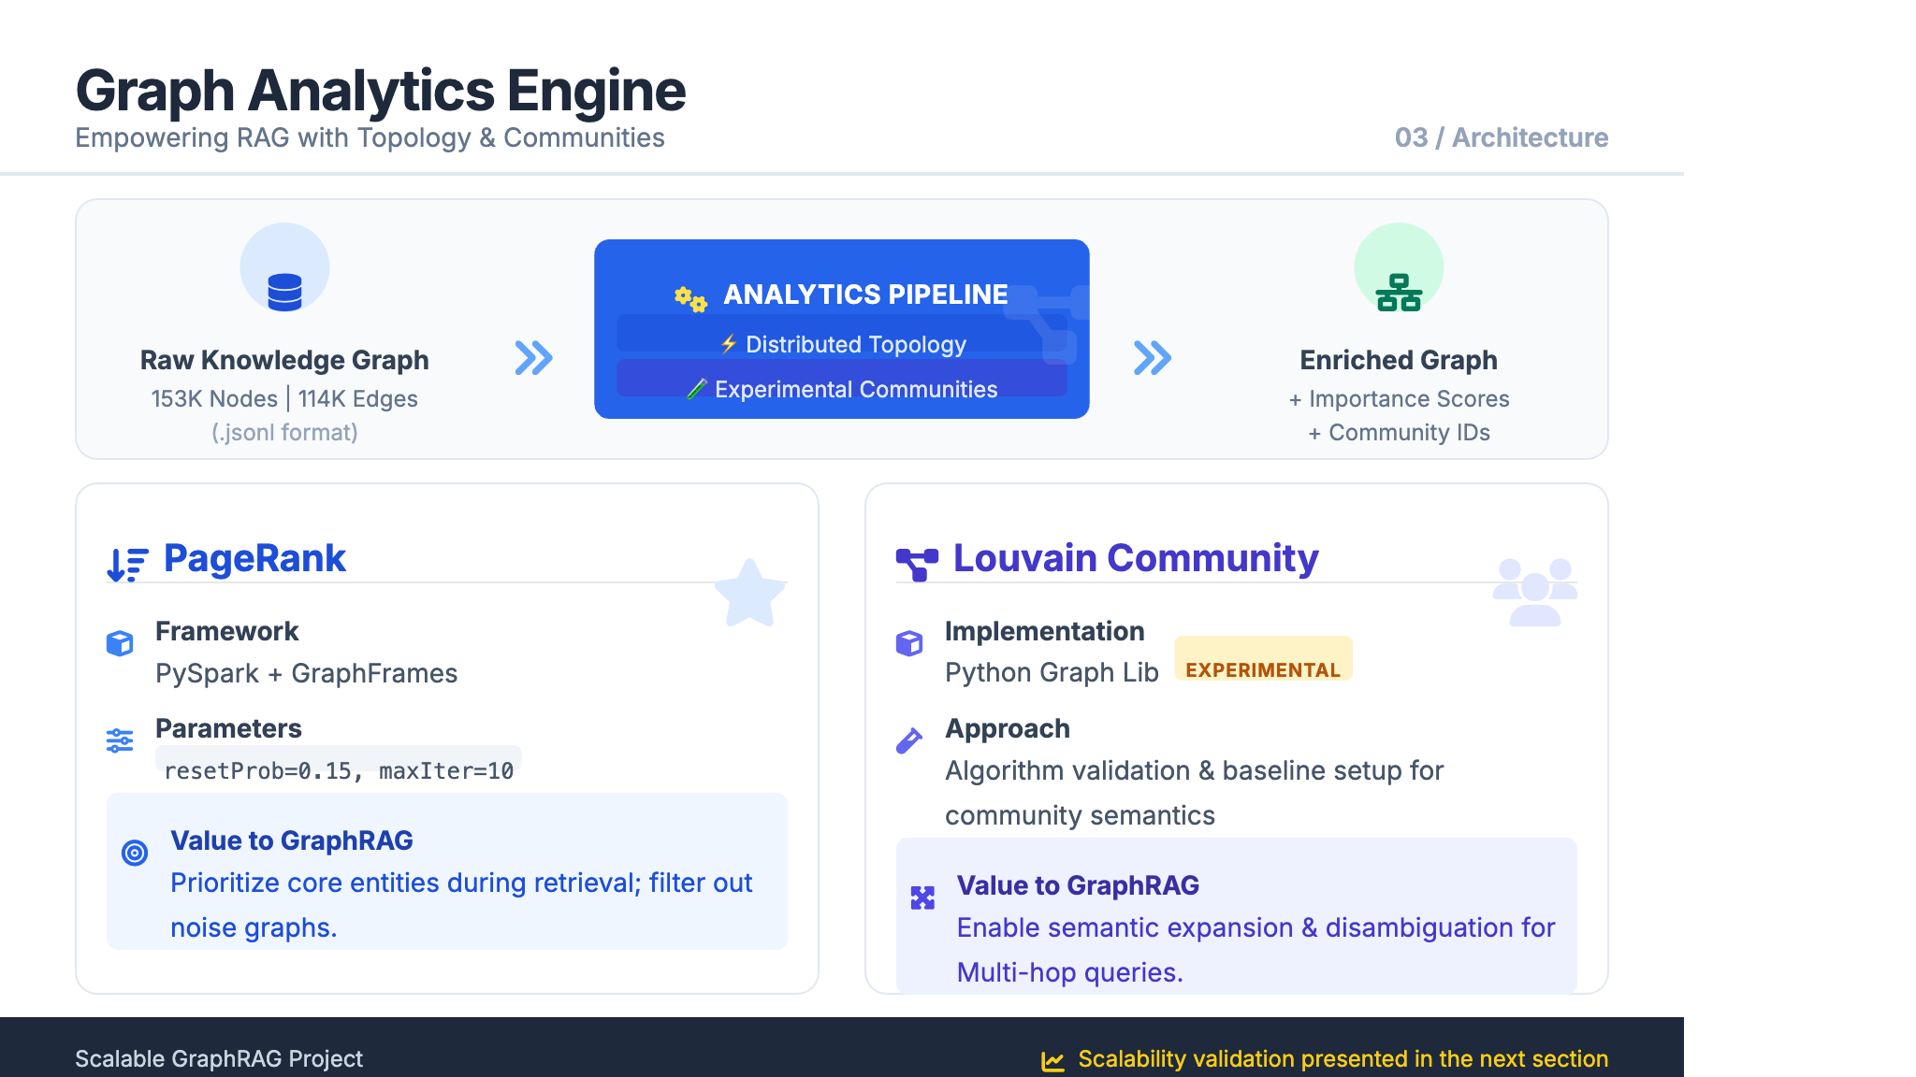

Slide 15
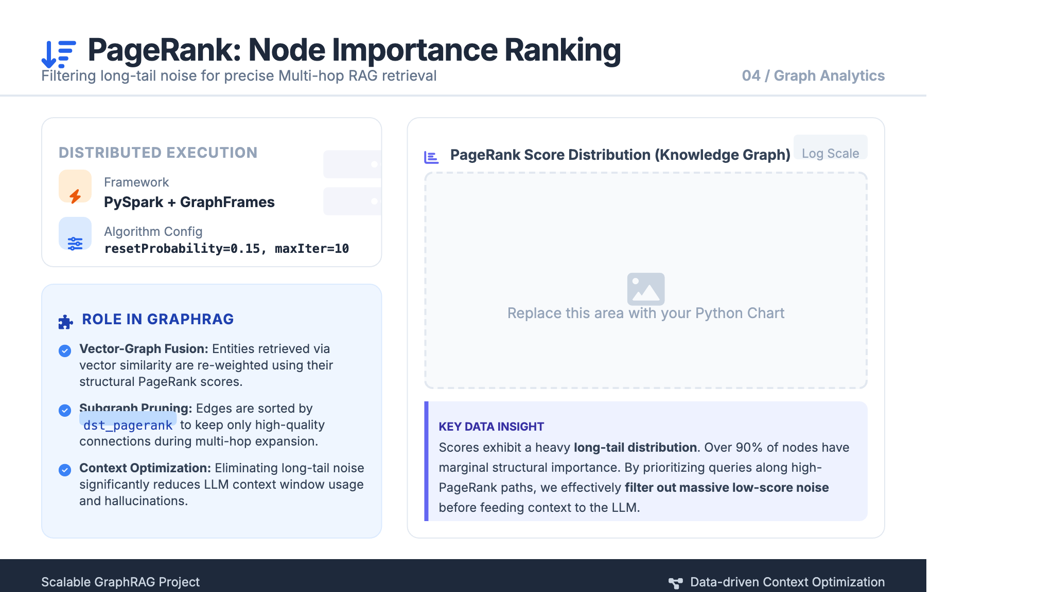
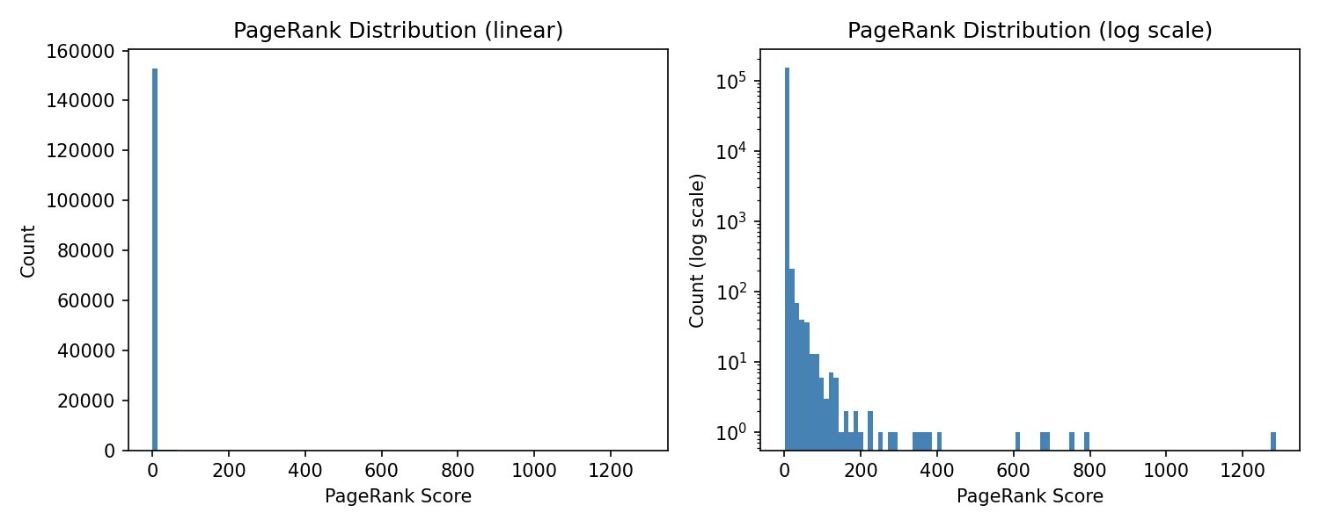

Slide 16
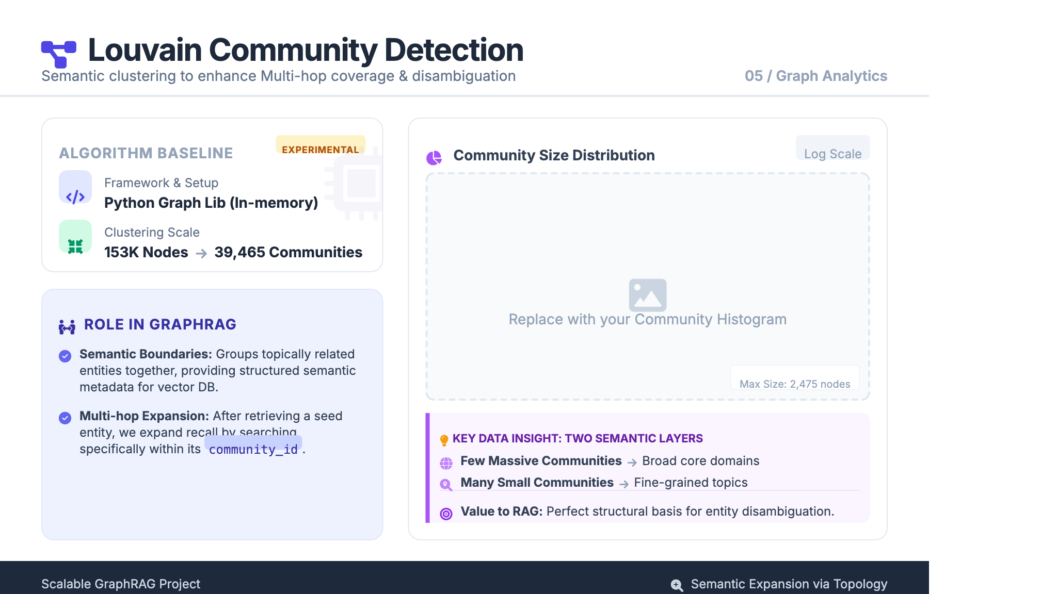
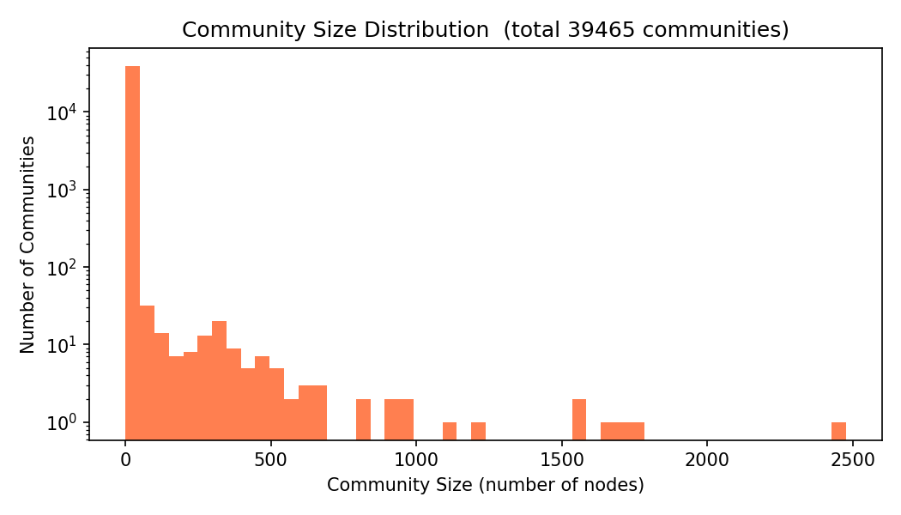

Slide 17
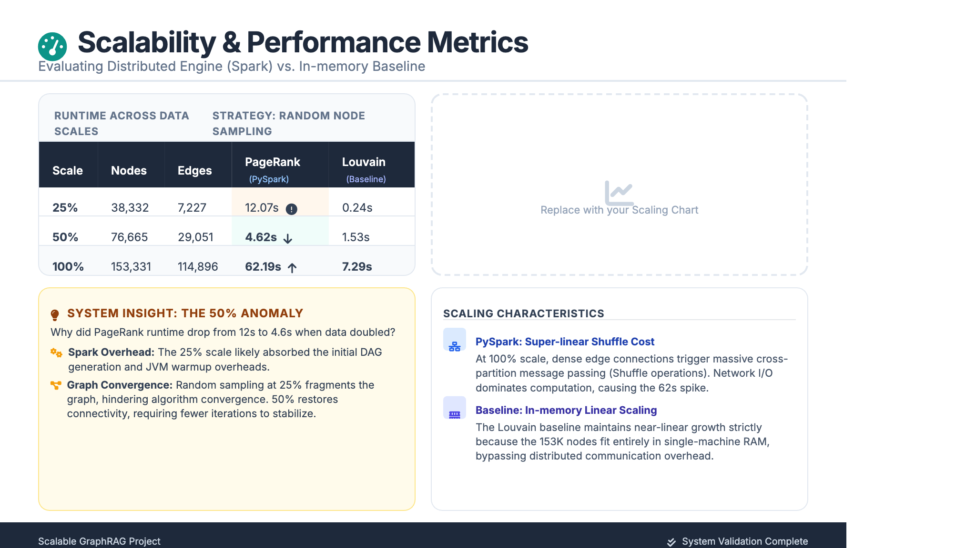
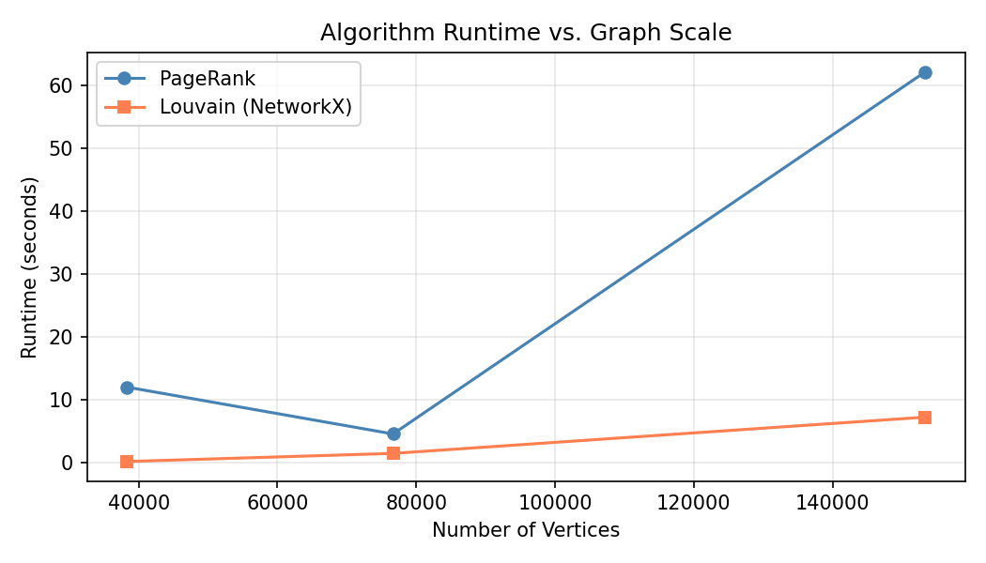

Slide 18
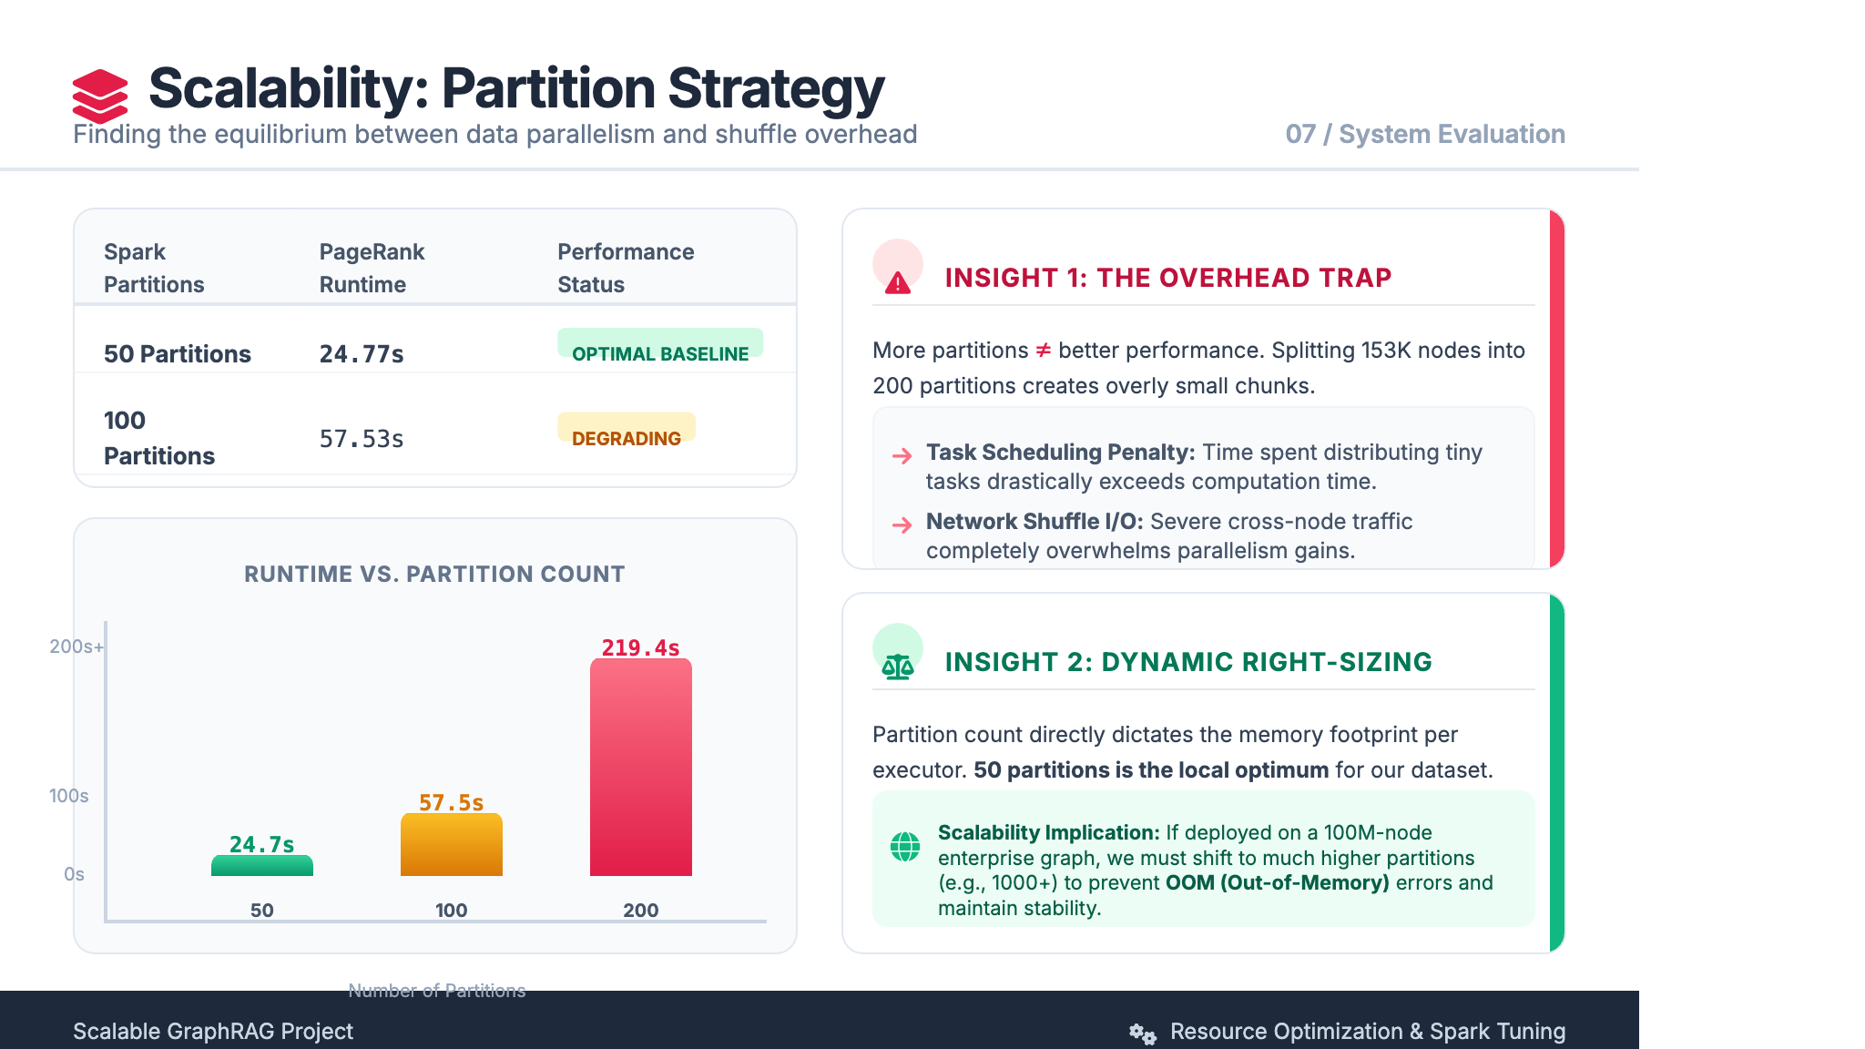

Slide 19
04
RAG System — Hybrid Retrieval
CHAPTER FOUR
From vector-only baseline to graph-guided evidence retrieval
22

Slide 20
System Architecture Overview
04 RAG System — Hybrid Retrieval
DATA LAYER
INDEX LAYER
RETRIEVAL LAYER
GEN LAYER
• clean_articles.jsonl
• vertices.jsonl
• edges.jsonl
• community_summary.jsonl
• Sentence-Transformers
• FAISS GPU (metric=ip)
• Community vector index
• Entity-doc alignment
• Vector search (FAISS)
• Graph expansion
• PageRank filtering
• Community expansion
• Evidence chunks
• Graph context
• LLM prompt
• Answer
Component Details
Text Indexing
Community & Graph Indexing
• Sentence-Transformers (all-MiniLM-L6-v2)
• FAISS GPU index with metric=ip
• Cosine similarity approximation
• 50K document full-indexing
• Vectorize community_summary
• Community index for query-to-community
• Graph-guided retrieval paths
• Evidence chunks as primary context
23

Slide 21
Key Artifacts & Data Flow
04 RAG System — Hybrid Retrieval
TEXT CORPUS
clean_articles.jsonl
50K document-level cleaned articles from Wikipedia parsing pipeline
CHUNK-LEVEL
ALIGNMENT TABLES
INVERTED INDEX
clean_article_chunks_50k
doc_entities.jsonl
entity_docs.jsonl
chunk_id=doc_id#i, chunk=1200 chars, overlap=200
doc_id → entity_ids mapping for graph alignment
entity_id → doc_ids for back-to-corpus retrieval
COMMUNITY INDEX
community_chunks.jsonl
chunk_id=community:<id> for community vector index
24

Slide 22
Retrieval Strategy — Three Versions
04 RAG System — Hybrid Retrieval
BASELINE
Vector-Only RAG
Query → FAISS top-k chunks → Vector Context → LLM → Answer
Control group to validate "does graph help multi-hop?"
HYBRID
GraphRAG Hybrid (Vector + Graph Edges)
Query → FAISS top-k chunks (seed docs) → doc_entities → 1-hop graph expansion → Prompt(Vector + Graph Context) → LLM → Answer
Validates "does adding graph context help reasoning?"
CORE
GraphRAG Graph-Guided (Core)
Query → FAISS chunks + community index → seed docs →
Graph produces retrieval paths; evidence chunks are primary evidence — "graph first, then text"
25

Slide 23
Graph-Guided Retrieval Pipeline
04 RAG System — Hybrid Retrieval
1. FAISS top-k
seed docs from vector search
2. Community Index
top communities reduce scope
3. PageRank Filter
prioritize important entities
4. Louvain Expand
intra-community neighbors
5. Graph 1-hop/2-hop
edges sorted by dst_pagerank
6. entity_docs
candidate doc_ids lookup
7. Embedding Rerank
extract & rerank chunks
8. LLM Generation
Evidence + Graph → Answer
↑ Graph Expansion Phase (Steps 1-5)
↓ Back-to-Corpus Phase (Steps 6-8)
26

Slide 24
Ranking & Denoising Strategy
04 RAG System — Hybrid Retrieval
RANKING SIGNAL
SCOPE CONTROL
PageRank Scoring
Community ID Filtering
• Entity candidate ranking by importance score
• Edge ranking: prioritize high-pagerank neighbors
• Enhances entity disambiguation
• Filters low-importance noise from expansion
• Community index first locates relevant community
• Reduces search scope dramatically
• Intra-community expand supplements neighbors
• Semantic coherence by community membership
Hard Limits (Prevent Prompt Explosion)
3
8
8
N
community_top_k
max communities per query
expand_entities_per_doc
max entities from each doc
expand_edges_per_entity
max edges per entity node
max_candidate_docs
max docs & chunks per doc
27

Slide 25
Implementation Highlights
04 RAG System — Hybrid Retrieval
MODULAR
SCALABLE
Decoupled Pipeline Design
50K Document Full-Indexing
• Indexing / alignment / inverted index / community index / retrieval / generation are fully decoupled
• Each module can be independently updated, tested, and replaced
• Clean interfaces via JSONL and Parquet artifacts
• Supports 50K document full-indexing with FAISS GPU
• Incremental updates possible without full rebuild
• Spark distributed pipeline scales to larger corpora
EXPLAINABLE
CONFIGURABLE
Traceable Evidence Chain
Tunable Parameters
• Outputs vector hits and graph expansion edges for every query
• Full evidence chain: query → seed → expand → rerank → answer
• Enables debugging and failure analysis
• community top-k, pagerank sorting, intra-community expand
• back-to-corpus limits, chunk size, overlap all tunable
• Easy ablation study configuration via YAML
28

Slide 26
05
Evaluation Framework
CHAPTER FIVE
HotpotQA-Based Local Benchmark and Ablation Study
29

Slide 27


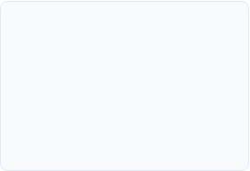






Why Build a Local Benchmark?
Section 05 | Evaluation Framework
Problem: Misattributing data scarcity as model weakness would lead to scientifically flawed conclusions.
Relevance
Graph Usability
Fairness
Deep Analysis
Ensures questions are strictly derived from the 50k Wikipedia corpus.
Validates if GraphRAG can physically navigate the extracted knowledge.
Eliminates external "knowledge gaps" between models and data.
Enables per-coverage-level failure analysis (Chunk vs. Graph vs. Path).
FILTERING PROCESS FOR LOCAL EVALUATION
* Local benchmark ensures the "Bridge" in multi-hop questions is traversable in the current graph.

Slide 28






05 Evaluation Framework | Methodology
EXP 1: Baseline RAG
EXP 2: GraphRAG (Standard)
EXP 3: GraphRAG + Toposort
CORE RESEARCH GOAL
CORE RESEARCH GOAL
CORE RESEARCH GOAL
Establish a performance floor. Evaluate if pure semantic similarity can resolve multi-hop dependencies without structural context.
Measure the value of "Structural Knowledge Injection". Can explicit triples fill reasoning gaps missed by vector retrieval?
Verify if the ordering of multi-hop evidence matters. Does a topology-aware sequence reduce LLM cognitive load and hallucinations?
Three-Stage Ablation Study Design

Slide 29




Evaluation Metrics Design
05 Evaluation Framework | Metrics System
ANSWER-LEVEL
RETRIEVAL-LEVEL
Answer Quality
Retrieval Quality
Exact Match (EM) Binary string matching after normalization for strict accuracy.
Support Title Recall Measures if retrieved chunks cover the Wikipedia pages tagged in HotpotQA.
Token F1 Score Calculates harmonic mean of precision and recall for flexible semantic overlap.
Local Doc ID Recall Precise alignment check using internal IDs to bypass title variation bias.
EVIDENCE AVAILABILITY
GRAPH USAGE
Evidence Coverage
Graph Utilization
Answer in Vector Context Percentage of cases where the answer exists in top-k text chunks. (Baseline Floor)
Graph Triple Density Tracks the volume of structured reasoning paths provided to the LLM.
Path Coverage Ratio Diagnoses if a physical 1-hop/2-hop path exists between supporting entities.
Answer in Full Context Detects if Graph Context supplements evidence missed by Vector search. (Graph Gain)

Slide 30
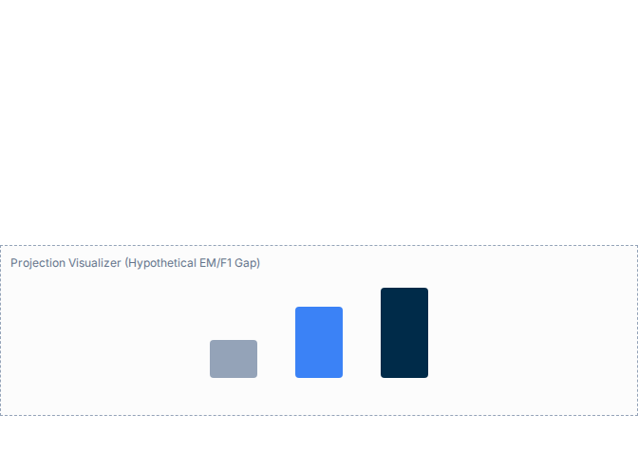


Performance Projections & Hypotheses
05 Evaluation Framework | Analysis Plan
Expected Performance Matrix (Preliminary Projections)
H1: Connectivity Gain
Method | EM | Token F1 | Supp. Recall | Ans in Full
Baseline RAG | 0.20 | 0.32 | 0.35 | 0.40
GraphRAG | 0.26 | 0.41 | 0.45 | 0.58
GraphRAG + Toposort | 0.30 | 0.46 | 0.45 | 0.58
Knowledge graph bridging will bypass "Semantic Gaps" in vector space, significantly increasing Supporting Document Recall.
H2: Evidence Backfill
Explicit triples will provide "Ghost Evidence" missed by chunk retrieval, boosting the presence of answers in context.
H3: Ordering Efficiency
Topological sorting aligns context with human reasoning chains, reducing LLM cognitive load and hallucination rates.
* Note: These are projected trends for the upcoming full-scale experiment. Final results are subject to the Knowledge Graph rebuild quality.

Slide 31
Limitations & Next Steps
05 Evaluation Framework
Current Limitations
Next Steps
• Graph coverage limited (50K articles, 115K edges)
• GraphRAG uses graph context only, not full graph-guided chunk retrieval
• Full results depend on rebuilt graph quality
• Louvain runs on single machine — not distributed
• Evaluation on local subset, not full HotpotQA
• Expected results are hypotheses, not validated
• Run experiments after graph rebuild
• Add 2-hop graph-guided chunk retrieval
• Analyze failure cases by coverage bucket
• Compare answer accuracy and evidence recall
• Migrate Louvain to Spark for scalability
• Expand corpus beyond 50K articles
36

Slide 32
Conclusion
THANK YOU FOR YOUR ATTENTION
• Built a scalable GraphRAG / Hybrid Retrieval system on Apache Spark
• Integrated Wikipedia + DBpedia dual-source KG (153K nodes, 115K edges)
• Applied PageRank + Louvain for topology-aware ranking and community expansion
• Designed graph-guided retrieval: graph produces paths, evidence chunks are primary context
• Established reproducible HotpotQA-based local benchmark for controlled ablation study
Q & A
Questions & Discussion
37

